Slide 1
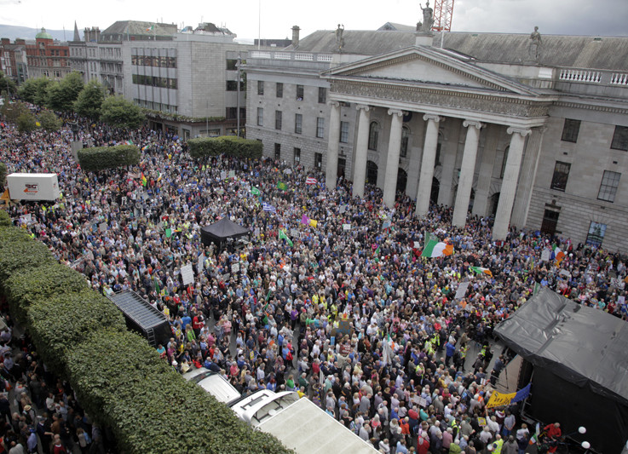


Slide 2
Need more investment?

Slide 3
Where’s the evidence?
“International research shows that installing domestic water meters is unlikely to make any real difference to the amount of water used by families. For example in the UK, Germany, and the Netherlands it has been found that metering each home makes little difference to the amount of water used by families.
SIPTU, 2011

Slide 4



Conservation?
  The UK average is 68,405 litres per person
  Irish Water - 54,750 litres per person
Metered Water Charges
No Water Meters

Slide 5
Economically inefficient!
Senior Executive Engineer for Water, Gerry Concannon, estimated that the cost of unmetered water is currently about €350.00 p.a. per domestic unit. When all of the costs of metering involving installation, maintenance, administration and replacement are considered he pointed out that this cost almost doubles. (2011)
“The proposed expenditure on water metering would mean spending more than €1 billion which we don’t have on something we don’t need!” Engineers Ireland, 2011

Slide 6
Domestic & commercial charges?
Households use 10% of the water (EU)
Corporations & Agriculture use 90% (EU)
Expected income 2015 (Alan Kelly, Dail April)
  Commercial: €229m (45%)
  Domestic: €271m (55%)
  Total: €500m
+ General Taxation (VAT, Motor Tax, etc) = public pay 78% of costs
Commercial companies are refusing to pay!
37% non-payment rate!
Alan Farrell TD (FG) on Claire Byrne show

Slide 7
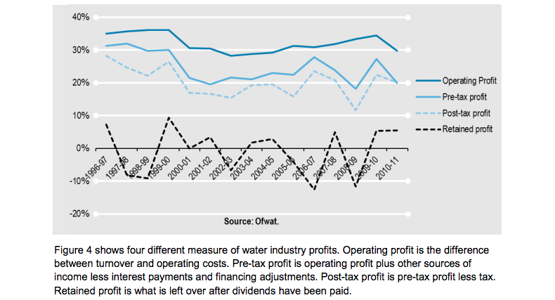
The real agenda - privatisation

Slide 8
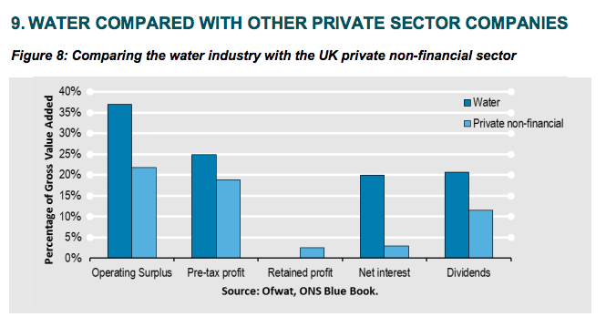

Slide 9
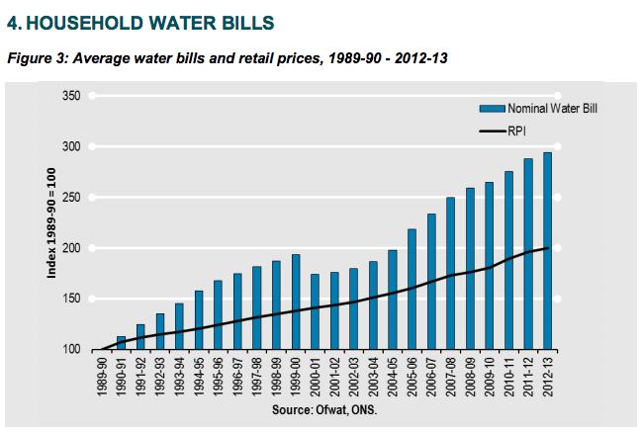

Slide 10
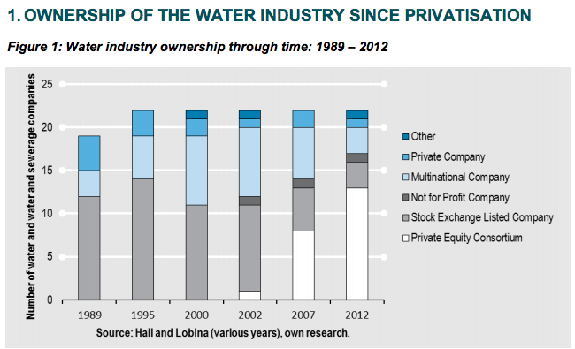

Slide 11
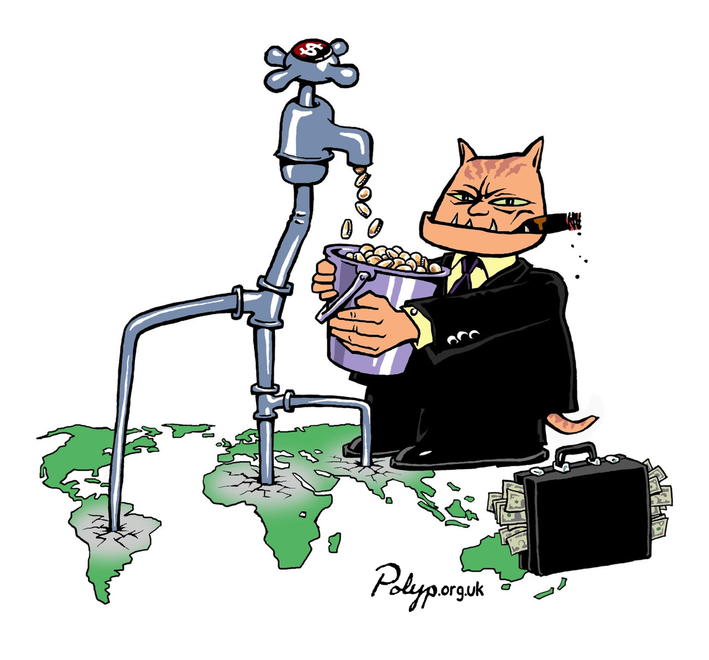
The Water Charges Model
In 2013 in Britain, private water companies made profits of: €2.81bn and paid €2.55bn to shareholders while paying only €101m in taxes.
Seven water companies paid no corporation tax at all and a report has shown that the industry is failing to help customers with “sky-high bills”.

Slide 12
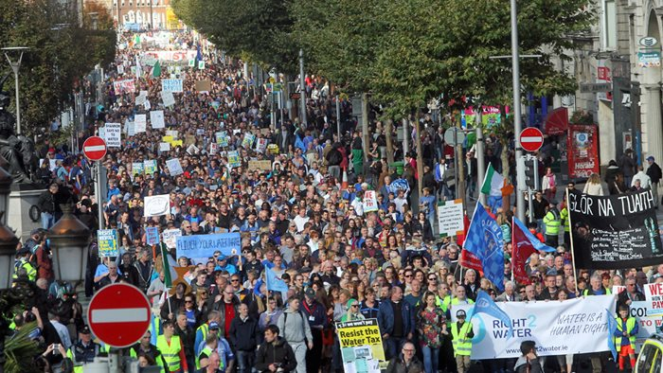
October 11th

Slide 13
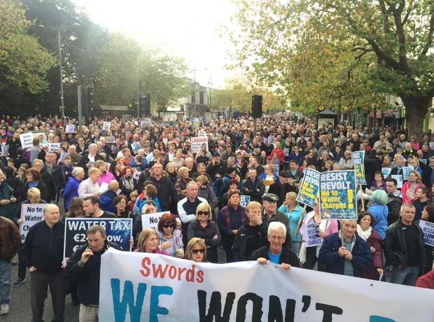
November 1st

Slide 14
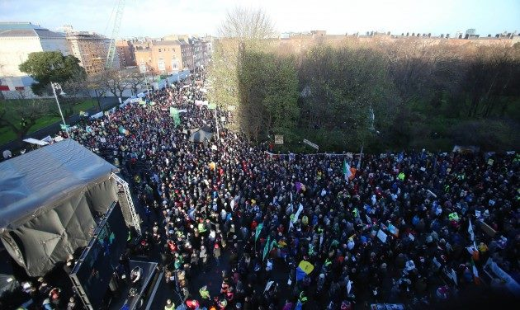
December 10th

Slide 15

March 21st

Slide 16
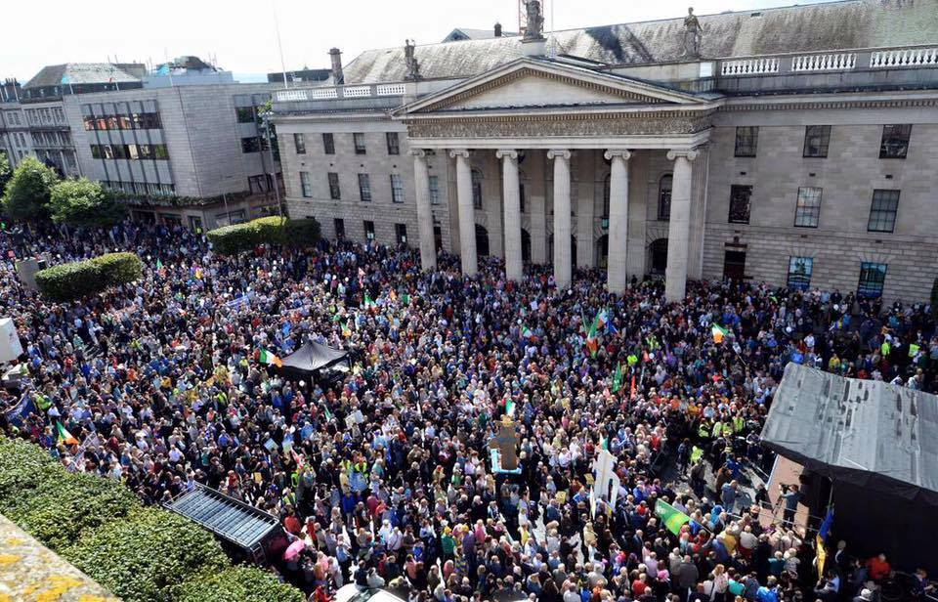
August 29th

Slide 17

January 23rd

